Slide 1
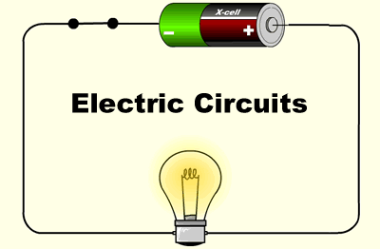
‘Click and Teach’ GCSE PHYSICS
TOPIC: Electric circuits
1 hour ‘lecture lesson’
You should have your book (or paper) and a pen ☺

Slide 2
Aims of the lesson
To understand basic electric circuits
To understand what voltage, current and resistance are
To be able to calculate resistance
In order to maintain social distancing and keep everyone safe:
You will need to copy from the board, rather than have worksheets
There will be EASY, MEDIUM or HARDER tasks for different abilities in the room
(c) Put your hand up if you need some help, but don’t leave your seat.
(d) Don’t share equipment, and keep your work with you at the end of the lesson.

Slide 4
Title: Flow of electricity
10 minute task:
Try and complete all three tasks if you think you can.
Easy: Copy each statement, and write down whether you think it’s true or false.
Medium: Rewrite any statement that you think is false, to make it true.
Hard: Explain why you think a statement is true or false.

Slide 5
Answers:
Discussion: What did you think?
First person: Not true, unless the knot is so tight that it damages the wire
Second person: Well, it could be true if the knot has damaged the wire, but that’s probably unlikely. So probably not true. The electrons can still flow through the wire, even if it curves and bends.
Third person: True. As long as a wire isn’t damaged, current should flow.

Slide 6
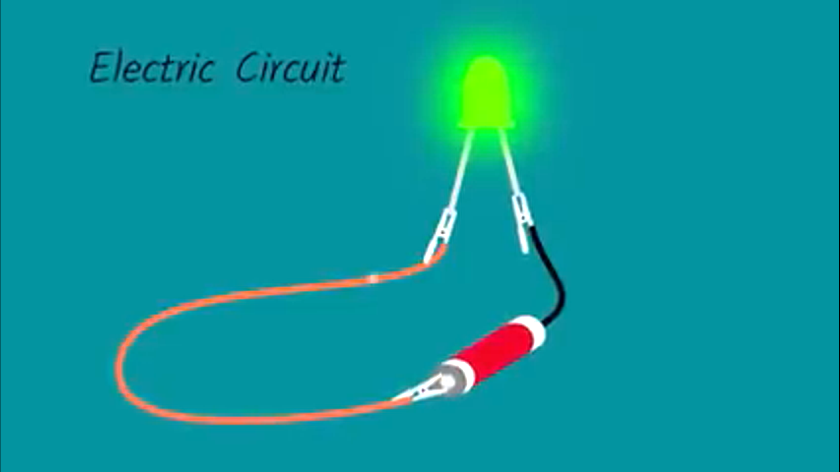
Title: Simple electric circuits Watch this 2 minute clip. They’ll be some simple questions to answer afterwards.
https://www.youtube.com/watch?v=oB1v-wh7EGU

Slide 7
Copy and answer ✓ Questions:
EASY
Which part of an atom is responsible for electric current?
(a) What is a conductor? (b) What is an insulator?
MEDIUM
3) Why do you think some materials are better conductors than others?
4) Why doesn’t electricity ‘burst out’ of wires when they break?
HARD
5) Do you think that the particles in the wire flow fast or slow? Explain your answer.

Slide 8
Answers ☺:
EASY
Which part of an atom is responsible for electric current? electrons
(a) What is a conductor? Something that lets electrons flow easily through it (b) What is an insulator? Something that doesn’t let electricity flow easily through it
MEDIUM
3) Why do you think some materials are better conductors than others? They have more ‘free’ electrons e.g. metals
4) Why doesn’t electricity ‘burst out’ of wires when they break? There is no longer a complete circuit, so everything stops.
HARD
5) Do you think that the particles in the wire flow fast or slow? Explain your answer. They actually move really slowly individually BUT they all move at once, making the electrical signal extremely fast (the speed of light!)

Slide 9
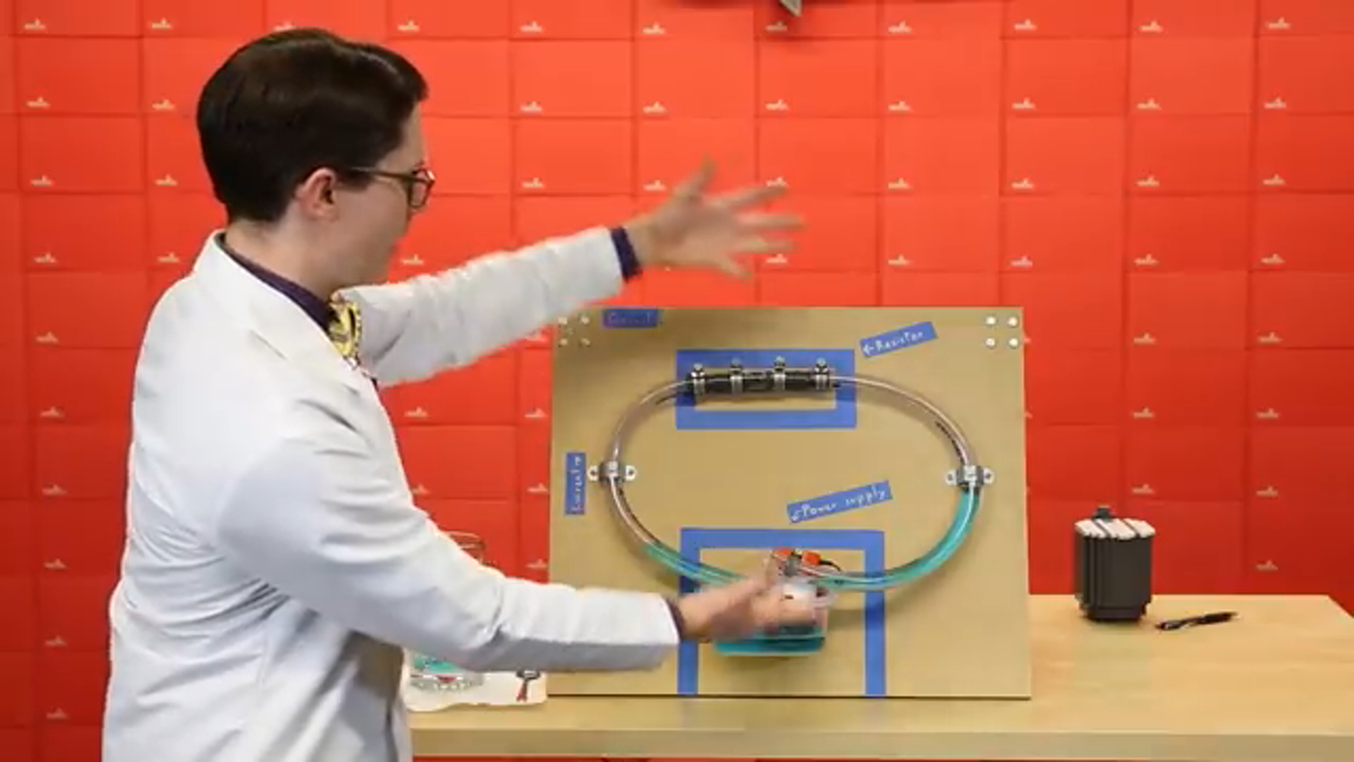
Title: Resistance in circuits Watch this 6 minute clip. They’ll be some questions and tasks to complete afterwards. You might want to make some notes as you go along, if you can multi-task ☺ https://www.youtube.com/watch?v=8jB6hDUqN0Y

Slide 10
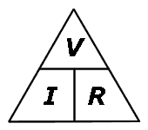
Try these EASY, MEDIUM and HARDER tasks
EASY – draw a labelled picture or diagram showing the main parts of a circuit (e.g. battery, bulb, wires, resistors)
MEDIUM: Copy out and complete these four questions.
What does a resistor do in a circuit?
What does (a) the pump, (b) the water (c) the tubes and (d) the steel wire represent in the circuit?
Voltage and Current are proportional – what does this mean?
What is the difference between voltage and current in a circuit?
HARDER: Ohm’s Law tells us how to calculate Resistance, in ohms, Ω.
Resistance = Voltage / Current. R = V/ I … we use symbol I for current.
5. Calculate the following resistances:
Voltage = 10V, Current = 2A
Voltage = 100V, Current = 5A
Voltage = 20V, Current = 4A
Voltage = ? Resistance = 20Ω Current = 3A
Current = ? Resistance = 40Ω, Voltage = 120V

Slide 11
Answers ☺:
EASY … basic electric circuit
MEDIUM:
A resistor tries to slow down the flow of electrons.
(a) the pump is like the battery (b) the water represents the flow of electrons (c) the tubes represent the wires (d) the steel wire represents resistance
Proportional – as voltage increases, so does the current.
Voltage ‘pushes’ the current OR Voltage provides the energy for the electrons to flow, making a current
HARDER:
5) (a) 5Ω (b) 20Ω (c) 5Ω (d) 60V (e) 3A

Slide 12
Aims of the lesson – how did we do?
To understand basic electric circuits
To understand what voltage, current and resistance are
To be able to calculate resistance

