Slide 1
‘Click and Teach’ GCSE CHEMISTRY
TOPIC: THE PERIODIC TABLE
1 hour ‘lecture lesson’
You should have your book (or paper) and a pen ☺

Slide 2
Aims of the lesson
To know the difference between groups and periods in the periodic table.
To know how the periodic table helps us remember the rules for filling shells.
To use groups and periods to help you deduce electronic configuration of an atom.
Be able to explain how you can use the position of an element in the periodic table to deduce which ion it will form.
In order to maintain social distancing and keep everyone safe:
You will need to copy from the board, rather than have worksheets
There will be EASY, MEDIUM or HARDER tasks for different abilities in the room
(c) Put your hand up if you need some help, but don’t leave your seat.
(d) Don’t share equipment, and keep your work with you at the end of the lesson.

Slide 3
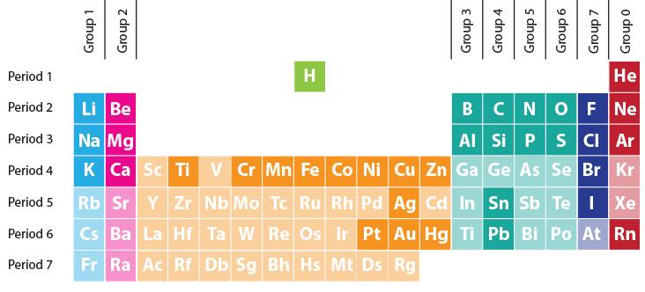
Title: Groups and periods Task 1 – 5 Minutes
Label up groups and periods on your periodic table.
Extension:
Can you write a word using symbols from the periodic table?

Slide 4
Task 2:Copy and answer ✓ Questions:
EASY
State the symbol for Fluorine.
Which period is hydrogen found in?
MEDIUM
3) Which period is Bromine found in?
4) Which group is aluminium found in?
HARD
5) Name the element found in group 4, period 2.
6) Name the element found in group 1, period 4.

Slide 5
Answers ☺:
EASY
State the symbol for Fluorine. F
Which period is hydrogen found in? Period 1
MEDIUM
3) Which period is Bromine found in? Period 4
4) Which group is aluminium found in? Group 1
HARD
5) Name the element found in group 4, period 2. Carbon
6) Name the element found in group 1, period 4. Potassium

Slide 6
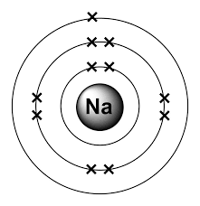
Task 3: Copy out and match the following up to the number of elements found in each period (5 minutes)
Period 1 8
Period 2 18
Period 3 2
Period 4 8
Extension: Can you relate the above to this diagram?

Slide 7
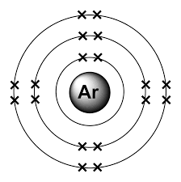
Task 3: Copy out and match the following up to the number of elements found in each period (5 minutes)
Period 1 8
Period 2 18
Period 3 2
Period 4 8
Extension: Can you relate the above to this diagram?
Shell one (nearest the nucleus) has 2 electrons in.
Shell two has 8 electrons in.
Shell three has 8 electrons
This is the same as the number of elements in period 1,2 and 3.

Slide 8
Look at the electronic configuration of sodium:
Where do we find sodium in the periodic table?
Group 1, Period 3
There is 1 electron in the outer shell
There are 3 shells

Slide 9
Look at the electronic configuration of oxygen:
Where do we find oxygen in the periodic table?
Group 6, Period 2
There are 6 electrons in the outer shell
There are 2 shells

Slide 10
Watch this video clip
https://www.youtube.com/watch?v=7mLPC74GHMo

Slide 11
How does the group and period relate to the electronic configuration?
The period tells you how many shells an atom has. If an element is in period 4, it will have 4 shells.
The group tells you how many electrons are in the outer shell. If the element is in group 3, it will have 3 electrons in the outer shell.
Copy the two sentences above into your notes.

Slide 12
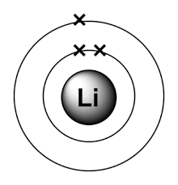
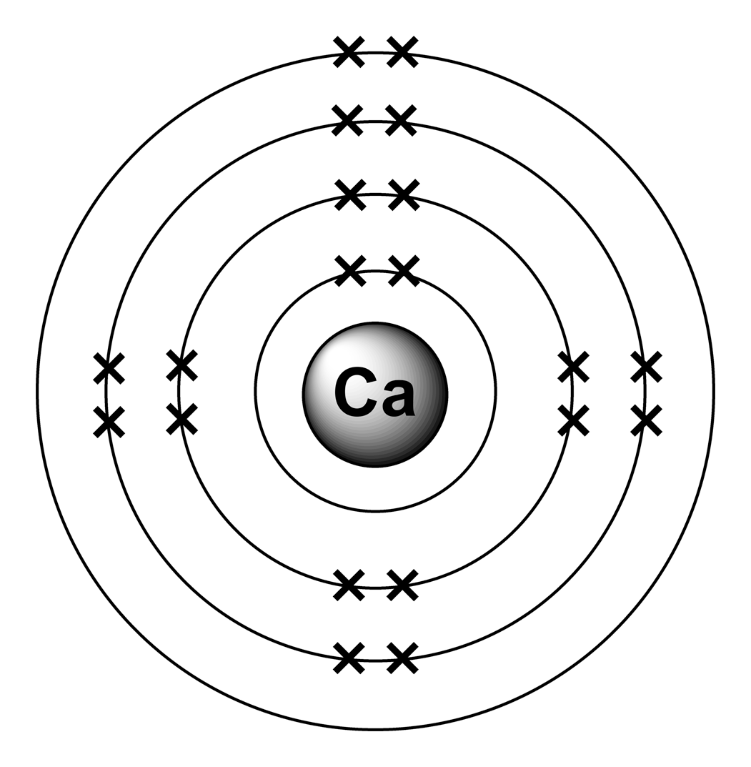
Copy out and complete the table (10 mins)
Electronic configuration | Period | Group
HARD: If you have time use the period and group to help you complete the table for Al and Be

Slide 13
Check your answers:
Electronic configuration | Period | Group
 | 2 | 5
 | 2 | 1
 | 4 | 2

Slide 14
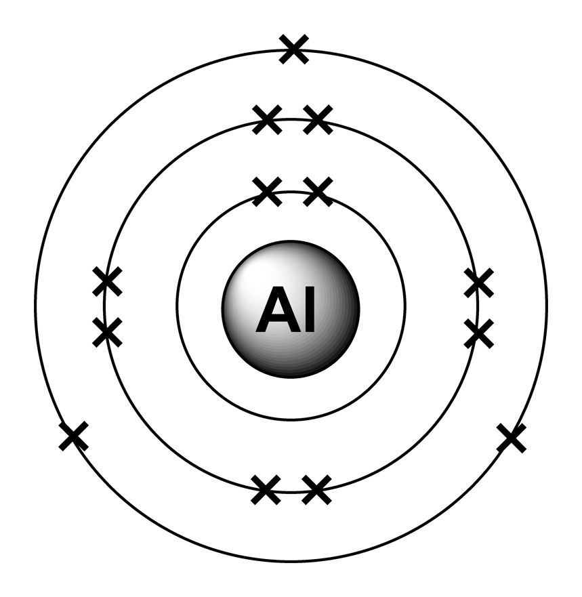
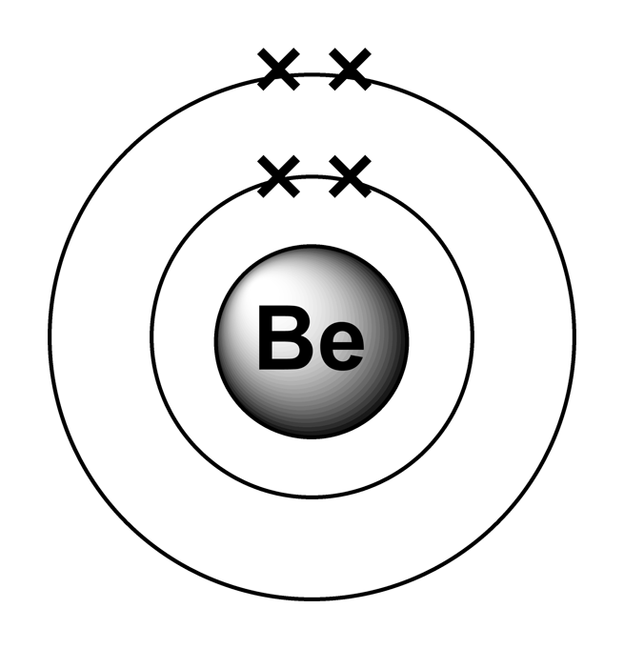
Check your answers (HARD):
Electronic configuration | Period | Group
 | 3 | 3
 | 2 | 2

Slide 15
What is an ion?
An ion is a charged particle, formed when an atom either loses or gains electrons

Slide 16
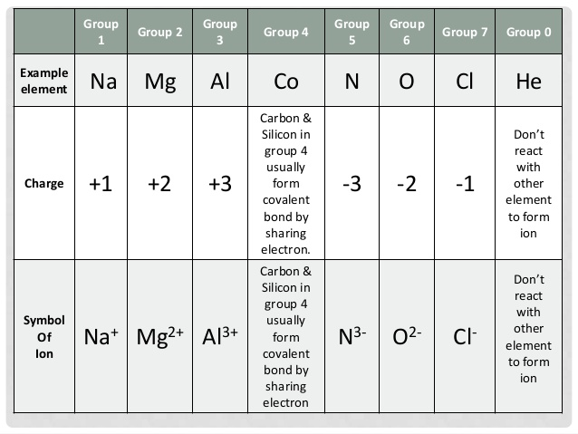
Which ions do elements form?
Can you see any patterns?

Slide 17
Which ions do elements form?
In your books write down which ion is formed for each group.
HARD: Draw a diagram to show the Magnesium ion

Slide 18
Aims of the lesson – how did we do?
To know the difference between groups and periods in the periodic table.
To know how the periodic table helps us remember the rules for filling shells.
To use groups and periods to help you deduce electronic configuration of an atom.
Be able to explain how you can use the position of an element in the periodic table to deduce which ion it will form.

Slide 19
BONUS VIDEO
If you’ve worked really efficiently:
Sit back and relax, no questions on this one:
https://www.youtube.com/watch?v=QA4cFCfoj7c
You may not thank me for this!

